Slide 1

League Winner Prediction Project
Machine Learning Application for English Premier League Analysis
Rishi Khandekar | BSc IT Student, Lords Universal College
Infosys Springboard 6.0 Internship

Slide 2



Project Challenge
The Goal
Predict English Premier League winners using historical team performance data and machine learning algorithms.
Classification Model
Performance Analysis
Analyze key performance indicators that contribute to championship success and compare multiple ML algorithms.
Predict league winners
Identify success factors
Algorithm Testing
Find best model

Slide 3
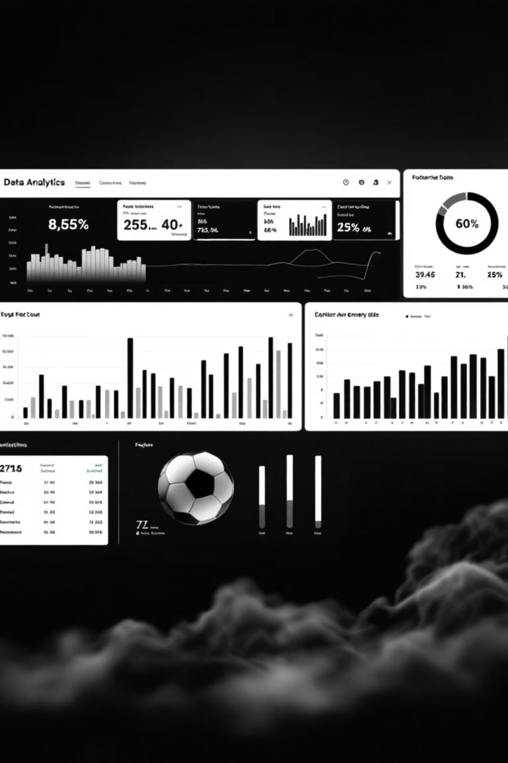
Dataset Overview
646
32
12
Records
Seasons
Features
Team performance entries
Years of EPL data (1992-2024)
Performance variables
Key Performance Metrics
Played: Total matches in season
Goal Difference (GD): GF minus GA
Won/Drawn/Lost: Match outcomes
Points: Total points earned
Goals For (GF): Goals scored
Position: Final league standing
Goals Against (GA): Goals conceded
Notes: Additional context

Slide 4




Data Preparation Pipeline
Data Cleaning
Missing value analysis, data type conversion, duplicate removal, outlier detection
Feature Engineering
Created binary 'Winner' target, removed leakage features, retained core metrics
Scaling
Applied StandardScaler for algorithm optimization

Slide 5



Exploratory Insights
Correlation Analysis Revealed
95%
89%
78%
Points & Wins
Goal Difference & Points
Goals For & Points

Slide 6

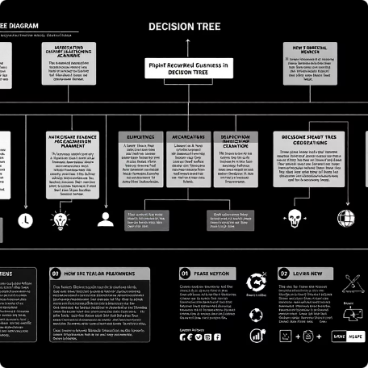


Machine Learning Arsenal
Logistic Regression
Decision Tree
Random Forest
XGBoost
Linear baseline model with L2 regularization
Non-linear, interpretable with pruning
Ensemble method with 100 estimators
Gradient boosting with regularization
Training Strategy: 80/20 train-test split, 5-fold cross-validation, GridSearchCV hyperparameter tuning

Slide 7
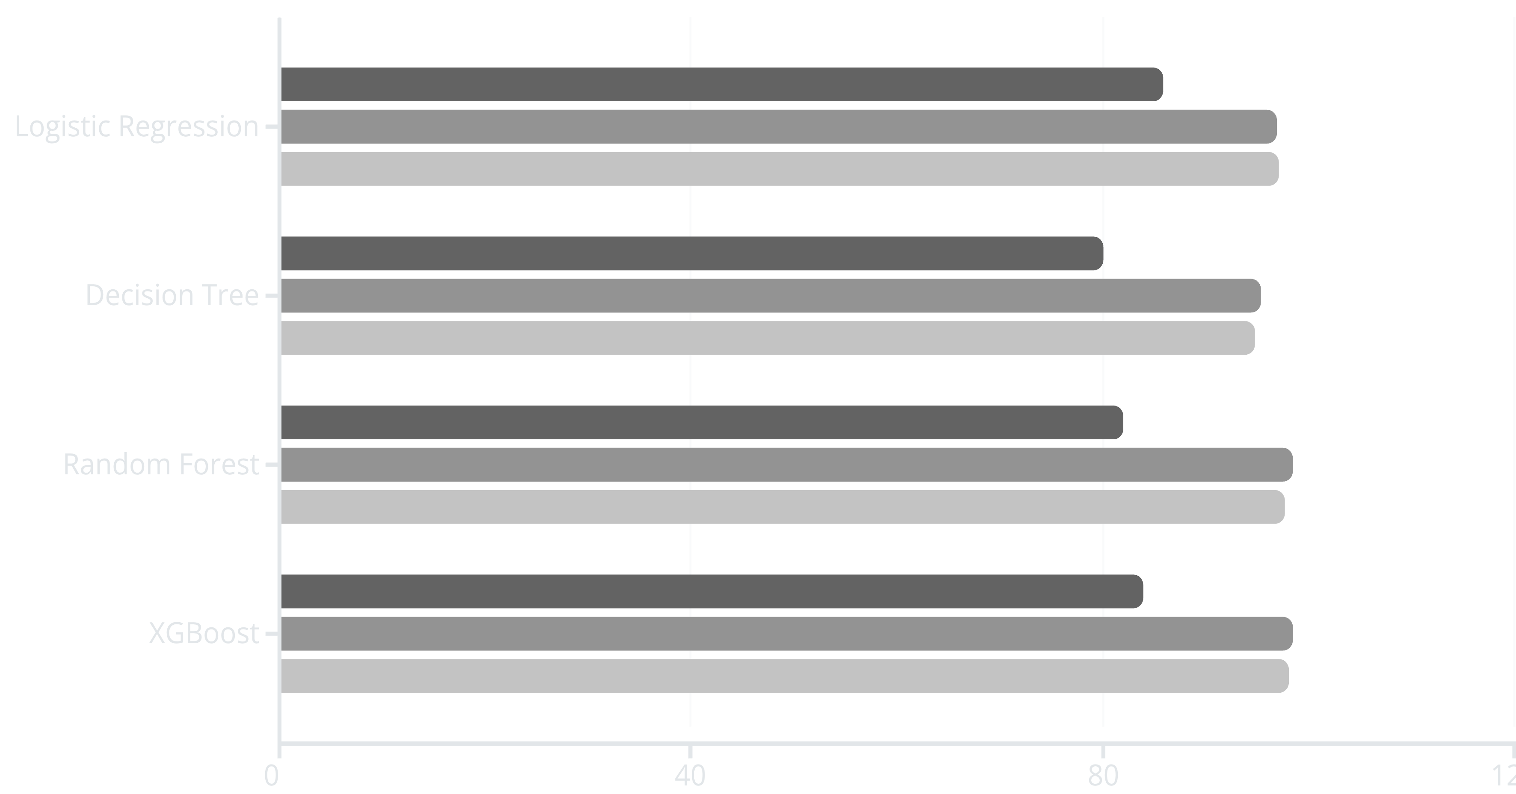
Performance Results
Training Accuracy
Testing Accuracy
Cross-Val Score
XGBoost and Random Forest achieved 98.5% testing accuracy with most consistent cross-validation performance

Slide 8





What Drives Championship Success?
Played (4%)
Minimal impact
Goals For (8%)
Moderate importance
Wins (15%)
Strong predictor
Goal Difference (28%)
Critical factor
Points (45%)
Most important
Key Insight: Points accumulation is the strongest predictor. Defensive solidity matters as much as attacking prowess.

Slide 9



Real-World Applications
Sports Analytics
Team performance evaluation, season forecasting, strategic planning for improvement areas
Betting & Fantasy Sports
Odds calculation, fantasy league guidance, risk assessment and probability quantification
Broadcasting & Media
Data-driven storylines, interactive prediction tools, historical performance comparisons
Future Enhancements
Data Enrichment
Advanced Modeling
Real-Time Apps
Player-level statistics
Time series analysis
Live predictions
Match-by-match analysis
Deep learning networks
API development
External factors
Hybrid ensembles
Interactive dashboards

Slide 10
Project Impact
78.5% Accuracy
Critical Insights
Practical Application
High-performance ML models successfully developed
Identified key success factors for champions
Demonstrated sports analytics value
Thank You
Rishi Khandekar
BSc IT Student | Lords Universal College
Infosys Springboard 6.0 Intern
Acknowledgments: Infosys Springboard 6.0 Program Team, Mentors, Technical Guides, and Premier League for publicly available data

